Slide 1
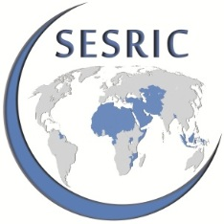
Islamic Finance Recent Trends
Statistical, Economic and Social Research and Training Centre for Islamic Countries
SESRIC
INTERNATIONAL CONFERENCE ON ISLAMIC BANKING | 29 - 30 MARCH 2014, TRIPOLI, LIBYA

Slide 2
Islamic Finance System
An Alternative to the Conventional System
The latest global financial crisis has triggered vigorous and wide-ranging debate on the role of the financial system (the conventional).
During the early phase of the crisis, there was almost international consensus, on the need to work out measures for restructuring the international financial architecture.
Many voices have even called for rethinking of other alternative financial systems.
A financial system based on Islamic principles was among these alternatives, and it was widely argued that such a system could avoid the fundamental problems and shortcomings of the conventional financial system that led the world into crisis.
Statistical, Economic and Social Research and Training Centre for Islamic Countries
Notes:
Currently, in majority of developed countries, debt is relatively more important than equity. That this is not sustainable has been shown many times by the debt crises in developed countries

Slide 3
Islamic Financial System
A more inclusive perspective of development
This system is widely referred to as Islamic Finance, Participation Finance or Equity-based Finance.
This system is, to a large extent, distinct from the conventional system. It is a more inclusive perspective of development.
Contrary to neo-classical development paradigm which emphasizes development of material factors and places undue reliance on market forces, Islamic finance would be driven by moral values, and gives primary importance to the realization of socio-economic justice and well-being of all humans.
So, Islamic Financial System places a balanced emphasis on both the material and spiritual aspects of life.
Statistical, Economic and Social Research and Training Centre for Islamic Countries
Notes:
Moreover, the neoliberal and market fundamentalist approaches for development (very elements of the Washington Consensus) have largely been invalidated so far.

Slide 4
Islamic Finance Industry
Current Developments
The contemporary practice of Islamic banking and finance is now over 30 years old.
Islamic Finance has rapidly transformed in the last decade to become internationally recognized and accepted as a competitive and robust form of financial intermediation by all communities.
The global Islamic finance industry continues to experience double digit growth rates of around 20%, with global Islamic finance assets being estimated at USD1.8 trillion in 2013 compared to $1.5 trillion in 2012.
Statistical, Economic and Social Research and Training Centre for Islamic Countries
Notes:
Currently, in majority of developed countries, debt is relatively more important than equity. That this is not sustainable has been shown many times by the debt crises in developed countries

Slide 5
Islamic Finance is Coming of Age
Global Assets of Islamic Finance
≈20%
≥95%
Average CAGR
2006-2012
Share of OIC Countries
Source: TheCityUK, The Banker, Ernst&Young
Since 2006, Islamic finance has been growing at a CAGR of around 20%, and in 2012, its global assets reached $1.5 trillion and estimated at $1.8 trillion in 2013
OIC member countries are home to over 95% of the global shariah-compliant assets
Statistical, Economic and Social Research and Training Centre for Islamic Countries

Slide 6
Regional distribution of Islamic finance assets
Regional distribution of sharia compliant assets, 2013
Source: The Banker
MENA accounts for almost four-fifths (77.8%) of global shariah-compliant assets whereas Asia has a one-fifth (20.8%) share
Statistical, Economic and Social Research and Training Centre for Islamic Countries

Slide 7
Regional dynamics
Regional growth in global assets of Islamic finance (2007-2013)
Source: The Banker
The growth in Islamic finance is mainly driven by the growth in MENA (with overall CAGRs of 18.5% and 17.4% in GCC- and Non-GCC-MENA since 2007, respectively.)
Statistical, Economic and Social Research and Training Centre for Islamic Countries

Slide 8
Islamic finance presence by country
Country-level decomposition of sharia compliant assets, 2013
Source: The Banker
Iran, Saudi Arabia, Malaysia, UAE and Kuwait remain the top 5 largest markets for Islamic finance –holding more than four-fifths (83.6%) of total sharia-compliant assets worldwide in 2013.
Statistical, Economic and Social Research and Training Centre for Islamic Countries

Slide 9
Islamic finance has inherent strenghts
Why would it avoid crises?
■ Efficiency gains
■ Linkage with real economic activity
■ Market discipline
■ Moral constraints (values)
ZONE OF SUSTAINABILITY
■ Equitable & efficient
distribution of credit
■ Socio-economic justice
ISLAMIC
FINANCE
■ Transparency and fairness
in business
■ Strong prudential advantages
■ Inclusion
■ Sharing of risk & reward
■ Overall development
and well-being
■ Stability
Avoidance of:
Riba (Interest)
Gharar (Uncertainty)
Maysir (Gambling)
Socio-economic Development Imperative
Business/Profit Imperative
Statistical, Economic and Social Research and Training Centre for Islamic Countries
Notes:
An Islamic financial system is the combined influence of three forces which can help prevent the recurrence of crises:
Moral constraints on the greed to maximize profit, wealth and consumption;
Market discipline which is expected to exercise a restraint on leverage, excessive lending and derivatives;
Reform of the system’s structure along with prudential regulation and supervision appropriately designed to prevent crises, achieve sustainable development and safeguard social interest.
One of the most important objectives of Islamic perspective of development is to realize greater justice in human society. This would not be possible unless all human institutions, including the financial system, contribute positively towards this end. All aspects of human life, social, economic, political and international, should adhere to moral values. This will help curb greed (avarice) which have made maximization of wealth and want satisfaction as the highest measure of human achievement.
Strong prudential advantages through prohibition of interest (riba), uncertainty (gharar ) and gambling (maysir)
Emphasis on linkage with the real economy, transparency and fairness in business relations, and risk-sharing among the parties (not risk-shifting!) through equity-based transactions
Aspires to be more human friendly financial system, where the priorities are given to overall socio-economic development, as opposed to individual improvements
Driven by moral values, and gives primary importance to the realization of socio-economic justice and well-being of all humans, contrary to neo-classical development paradigm, which emphasizes development of material factors and places undue reliance on market forces
Efficiency gains by the choice of interest-free operations
Allows for a more equitable and efficient distribution of credit.
In conventional banking, utmost attention is given to the ability to repay loans which relies on the provisions of collaterals and guarantees. Hence, the rich has the most access to finance.
In contrast, a participatory financial systems is more concerned about profitability and value-added, and less about collateral as funds are provided on equity or profit-sharing basis. Those who have worthy investment projects even they are not wealthy, have a chance of obtaining finance. (Positive implications for the SMEs)

Slide 10
Factors driving the growth of Islamic finance
Endogenous factors
Demand-driven industry
Increasing demand for Islamic system along with the opportunities for its expression in Islamic finance
Successful track record of Islamic FIs which increased public’s trust in them,
Industry-driven approach to IF (vs. a high dependence on a regulator-led model in some other countries)
Exogenous factors
Outflow of funds from advanced financial markets to the emerging economies due to uncertain environment in the former (economic and financial instability, etc.)
Rising oil prices
Strong economic growth
Booming real estate sector – particularly in the GCC countries
Statistical, Economic and Social Research and Training Centre for Islamic Countries

Slide 11
Islamic finance is the preferred mode of finance
“
Religious reasons for not having a formal account are most commonly cited in the Middle East and North Africa and South Asia. In these regions, developing financial products compatible with religious beliefs (Islamic finance) could pay off—potentially increasing the share of adults with a formal account by up to 10 percentage points in the Middle East and North Africa and by up to 5 percentage points in South Asia
Demirguc-Kunt and Klapper (The World Bank, 2012)
”
Statistical, Economic and Social Research and Training Centre for Islamic Countries

Slide 12
Islamic finance is the preferred mode of finance
COUNTRY | SURVEY (YEAR) | RESULT
Algeria | Frankfurt School of Finance and Management (Bankacademie International) (2006) | A study revealed that 20.7% of microenterprise owners do not apply for loans primarily because of religious reasons.
Indonesia | Bank Indonesia (2000) | In East Java, 49% of the rural population considers interest prohibited and would prefer to bank with Sharia-compliant financial institutions.
Jordan | IFC and FINCA (2006) | Studies show that 25% and 32%, respectively, of those interviewed cite religious reasons for not seeking conventional loans. The study also showed that 18.6% of those interviewed rank religious reasons as the single most important factor in their decision on obtaining a loan.
Lebanon | Hamze (2001) | The success in outreach of Islamic programs relative to conventional microfinance institutions strongly suggests that large numbers of poor people prefer Islamic finance. In addition, microfinance practitioners report that many of the poor refuse financial services unless they are Sharia-compliant.
Palestine | PlaNet Finance (2007) | More than 60% of low-income survey respondents claim a preference for Islamic products over conventional products. More than half of such respondents prefer such products even if they come at a higher price.
Syria | IFC (2007) | Survey revealed that 43% of respondents considered religious reasons to be the largest obstacle to obtaining microcredit. In addition, 46 percent of respondents who had never applied for a loan stated that religious reasons were the primary reason they had never applied. Nearly 5 percent of current borrowers said they would not apply for another loan for religious reasons
Yemen | National Microfinance Foundation | An estimated 40% of the poor demand Islamic financial services, regardless of price
Afghanistan, Indonesia, Syria, and Yemen | FINCA (Afghanistan), German Technical Cooperation (Indonesia), Sanadiq in Jabal-al-Hoss (Syria), Social Fund for Sustainable Development (Yemen), and Hodeidah Microfinance Program (Yemen) | Microfinance practitioners (please see left) indicate That in these countries some conventional microborrowers tend to switch over once Islamic products become available (CGAP, 2008).
Statistical, Economic and Social Research and Training Centre for Islamic Countries

Slide 13
Muslim population dynamics in the world
Muslim population, as the core customer base for Islamic financial services, is projected to increase from 1.6 billion to 2.2 billion by 2030 – an increase by 35.2%
Major economies will also experience a significant increase in the relative sizes of their Muslim population - turning these economies into more accessible markets for Islamic financial services
Statistical, Economic and Social Research and Training Centre for Islamic Countries

Slide 14
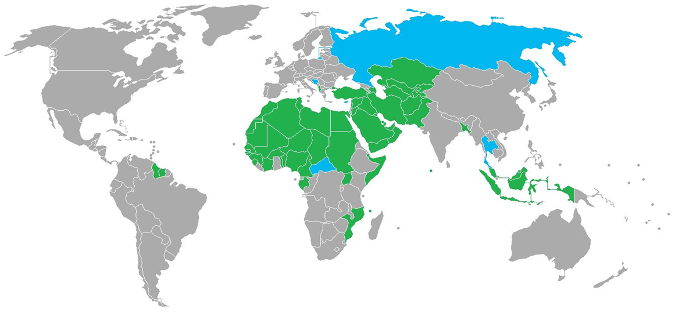
Core Islamic finance infrastructure is inadequate
Islamic finance infrastructure in OIC member countries
In many countries, IFIs are regulated and supervised in the same way as traditional banks on conventional prudential regulatory frameworks.
Weak or no infrastructure
Some infrastructure
Relatively developed infrastructure
Source: Ernst &Young (2011a)
Enabling legislative, regulatory, legal, accounting, tax, human capital, and Shariah business frameworks are not in place. This, in turn, increases the operational risks, and creates a negative incentive for IFIs to offer Islamic financial services in the region.
Statistical, Economic and Social Research and Training Centre for Islamic Countries

Slide 15
Sukuk potential remains largely unutilized
Sukuk by Country of Origin (1996-2011)
Sukuk by Issue Type (1996-2011)
Source: Zawya
Malaysia alone accounts for two-thirds (65.6%) of the total sukuks issued between 1996-2011 – almost twice the GCC where almost one-third of the total issues come from
North Africa and Sub-Saharan Africa are largely missing the opportunity to tap into the pool of Islamic funds for its development needs through Sukuk market.
Statistical, Economic and Social Research and Training Centre for Islamic Countries

Slide 16
Towards a More Stable Financial System
How could Islamic finance help?
At a time when world leaders are calling for financial reforms, it is imperative to have our financial systems restored to widely accepted ethical and moral bases to serve the common good of humanity. In this regard, Islamic finance help finance industry
make best practices widespread
enhance business ethics and transparency
have proper regulations to be applied to all players and instruments
encourage healthy expansion of credit tied to the real sector
reduce the role of debt financing and shift the focus towards equity financing
curb greed for excess risk-taking and short-term profit (financial myopia), and discourage unethical transactions
set long-term development targets
develop more inclusive financial products and services
Statistical, Economic and Social Research and Training Centre for Islamic Countries
Notes:
Consequently, the conventional financial system lacks all these aforementioned principles of Islamic finance and this deficiency was the main reasons that contributed to the current financial crisis. Actually, the essential principles of Islamic finance are not specific to the Islamic faith. Therefore, the main message of Islamic finance, while ethical, is also universal.

Slide 17
Thank you for your attention
www.sesric.org
https://twitter.com/sesric

