Slide 1
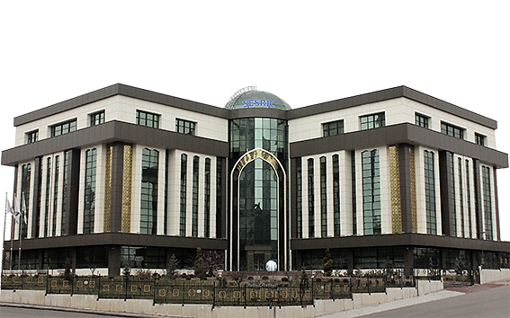
SOUTH-SOUTH COOPERATION FOR SOCIO-ECONOMIC DEVELOPMENT OF THE SOUTH: THE EXPERIENCE OF SESRIC
Nebil Dabur
Director General, SESRIC

Slide 2
OUTLINE
SSC: Concept, History, Features, Principles, Modalities
SESRIC: Mandates and Member Countries of the OIC
SESRIC Experience in SSC: Statistics, Research and Training

Slide 3
SSC: THE CONCEPT
Aims at
Sharing/transferring knowledge/skills/expertise/resources through various modalities in order to meet development goals.
Fostering self-reliance of developing countries by enhancing their capacities to find solutions to their development problems while keeping with their own aspirations, values, and special needs.
Bilateral or Multilateral Initiative

Slide 4
SSC: HISTORY
The end of World War II; Newly independent Southern countries coalesced around shared political aspirations; establishment of the Arab League
The 1st UNCTAD Conference and the establishment of the group G-77 in UN with a view to promoting south-south cooperation for development
1945
1955
1964
1978
In the first large-scale Asian-African Conference ‘the Bandung Conference’ in Indonesia, Representatives from 29 nations unanimously adopted a 10 point “declaration on promotion of world peace & cooperation”
The 1st High-Level UN Conference on SSC in Buenos Aires “Conference of the Global South on Technical Cooperation among Developing Countries (TCDC)”. The adoption of the Buenos Aires Plan of Action (BAPA) for Promoting & Implementing TCDC

Slide 5
SSC: HISTORY
On the occasion of the 30th anniversary of the 1st UN Conference on SSC, the High-level UN Conference on SSC in Kenya resulted in the Nairobi outcome document that highlights the roles of national governments, regional entities, & UN agencies in supporting & implementing South-South & triangular cooperation
1989
2009
2019
The 9th non-aligned movement summit established an international organization originally known as the “group for south-south Consultation and Coordination”
The 2nd High-Level UN Conference on SSC celebrating the 40th anniversary of Buenos Aires Plan of Action (BAPA+40 Conference). Buenos Aires outcome document was adopted to guide the South-South cooperation of the future

Slide 6
SSC: SPECIFIC FEATURES
CAPACITY DEVELOPMENT
HORIZONTAL PARTNERSHIP
DIVERSITY OF CHOICES
COST EFFECTIVENESS
DEMAND DRIVEN CHARACTER
ADAPTABILITY

Slide 7
SSC: PRINCIPLES
Non-Interference in Internal National Interests or issues
Diversification of Ideas
Simplicity & Speed of Execution
Considering Sensitivity to Specific Contexts
More Flexibility
Promoting Self-Sufficiency
Preservation of Diversity & Cultural Identity
Respect for Independence & National Sovereignty
Adaptation to National Priorities
Ensuring Equality between Partner Countries
Preference for the Use of Local Resources

Slide 8
SSC: MODALITIES
SHARING EXPERIENCES AND GOOD PRACTICES
Exchange of knowledge, experience, and expertise among countries
STRENGTHENING OF NETWORKS
Several institutions from difference countries form a network and work together within this network
CAPACITY BUILDING
Increasing the ability of a southern country to promote development through enhancing institutional (equipment purchase) and human resources capacities (trainings)
PARTNERSHIP DEVELOPMENT
Setting up a common developmental project (Joint venture)
Notes:
As to the main modalities of South-South cooperation, UNESCO differentiates the types of cooperation as follows:
• Sharing experiences and good practices: one or more developing countries with experience and expertise in a certain domain exchange(s) this experience and expertise with one or more other developing countries.
• Strengthening of networks: several institutions from different developing countries form a network and work together within this network.
• Capacity-building: Capacity-building in the context of South-South Cooperation is about increasing the ability of a southern country to promote development. The southern countries help each other build up their capacity to promote development. For example, capacity-building can include the training of personnel and the purchase of equipment.
• Partnership development: the developing countries start a partnership and set up a common project to build on development.

Slide 9
SESRIC
Statistical, Economic and Social Research and Training Centre for Islamic Countries (SESRIC)
Subsidiary organ of the Organization of Islamic Cooperation (OIC)
Resolution No. 2/8-E adopted by the 8th Islamic Conference of Foreign Ministers (ICFM), held in Tripoli in May 1977
Operating in Ankara, Republic of Turkey since June 1978.

Slide 10
THE MANDATES OF SESRIC: SESRIC’S ROLE IN STRENGTHENING SOUTH-SOUTH COOPERATION
SOUTH-SOUTH COOPERATION
STATISTICS
RESEARCH
TRAINING

Slide 11
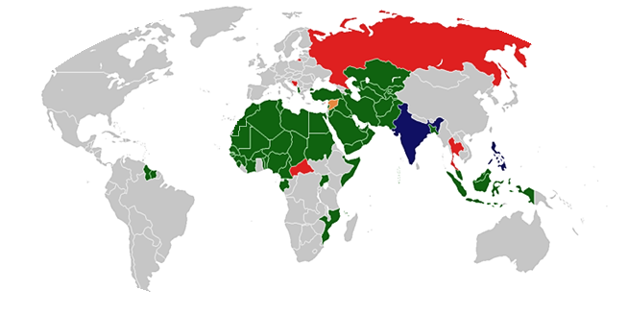
OIC MEMBER STATES
Member States
Observer States
Suspended States
Membership Attempts
24.4% of total world population and 39.7% of total population of Non-OIC Developing Countries
[51.6% of total OIC population are aged 0 – 24 (Young People)]
56.9% of global proven Natural Gas reserves and 64.4% of global proven Crude Oil reserves
28.4% of total Agricultural Land in the world
8.1% of World Production, 9.6% of World Merchandise Exports, 5.8% of total World FDI Stocks
Economic Activities are Concentrated in few countries (70% by only 10 Countries)

Slide 12
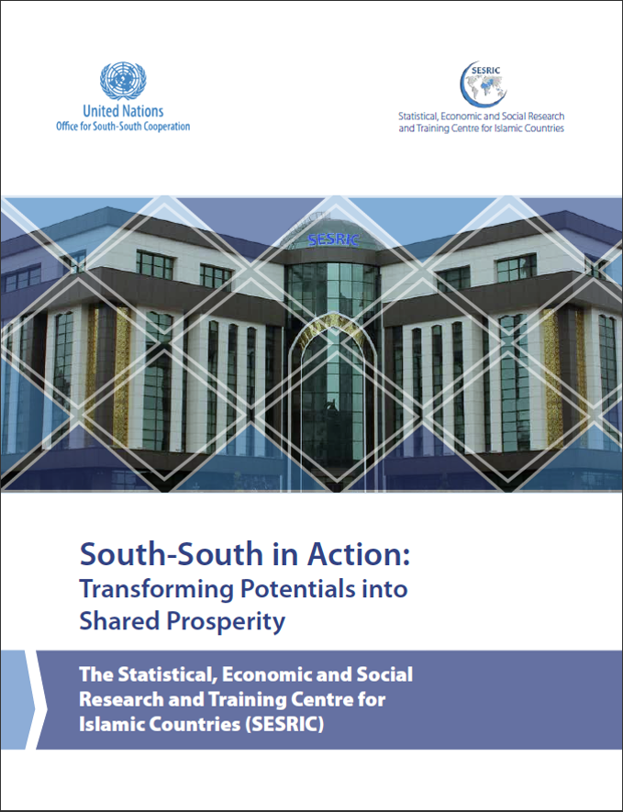
SESRIC’S EXPERIENCE OF SOUTH-SOUTH COOPERATION
Access the report at https://www.sesric.org

Slide 13
COMPILING AND DISSEMINATING STATISTICS TO FACILITATE SSC
Data and Information Hub on OIC MCs
SESRIC Statistical Capacity Building Programme
OICStat & Other Tools
StatCaB
Statistical Publications
OIC-StatCom
The only OIC cooperation fora in the domain of statistics
Yearbooks, Outlooks, and others

Slide 14
SESRIC STATISTICAL CAPACITY BUILDING (STATCAB) PROGRAMME
Flagship Capacity Building Program
2007
Achievements
Year of Initiation
309 StatCaB activities organised,
for the benefit of 51 OIC countries, provided by 26 OIC countries
Biennial
StatCaB Questionnaire
Modalities
Short-term Statistical Training Courses, Technical Missions, Workshops, and Online Courses
Analysis and Identification
Matching
the statistical needs and capacities of OIC countries

Slide 15
RELEVANCE OF OIC-STATCOM TO SSC
Established in 2010. First session in 2011.
Secretariat by SESRIC.
Covering the most recent international statistical agenda.
Acts as the only cooperation fora for exchanging experiences among the OIC countries to develop statistical capacity.
A unique approach for strengthening solidarity among members
based on South-South Cooperation principles.

Slide 16
RESEARCH-POLICY NEXUS
RESEARCH
To study and evaluate the economic and social developments in the member countries to help generate proposals that will initiate and enhance co-operation among them.
POLICY DIRECTION
COOPERATION
MONITORING AND EVALUATION

Slide 17
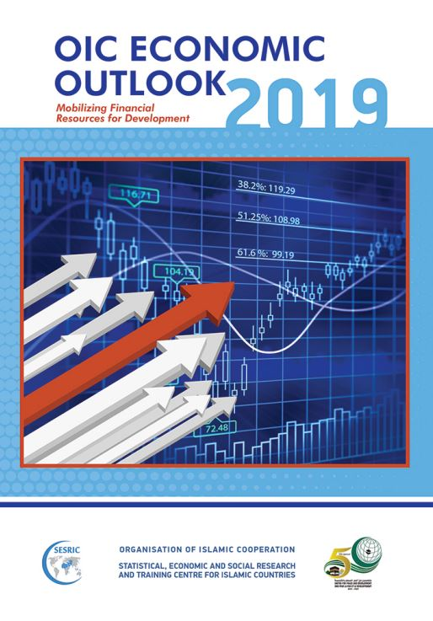
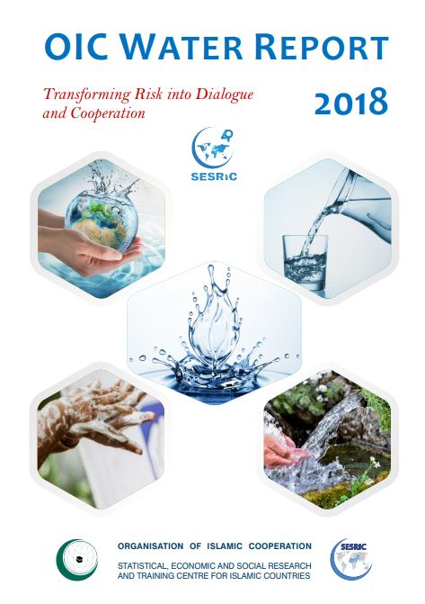
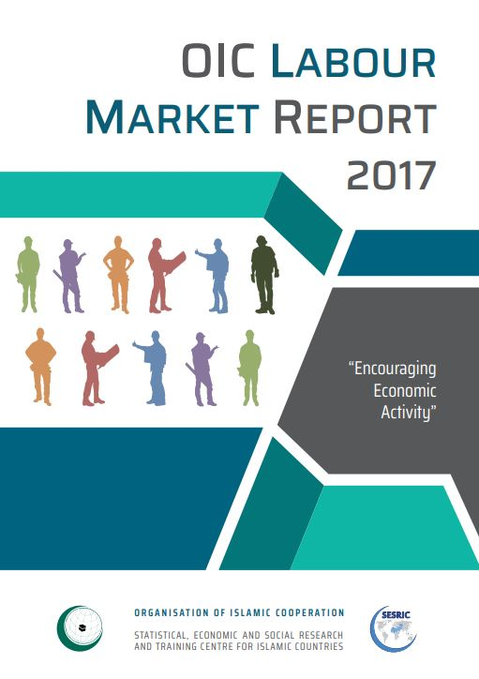
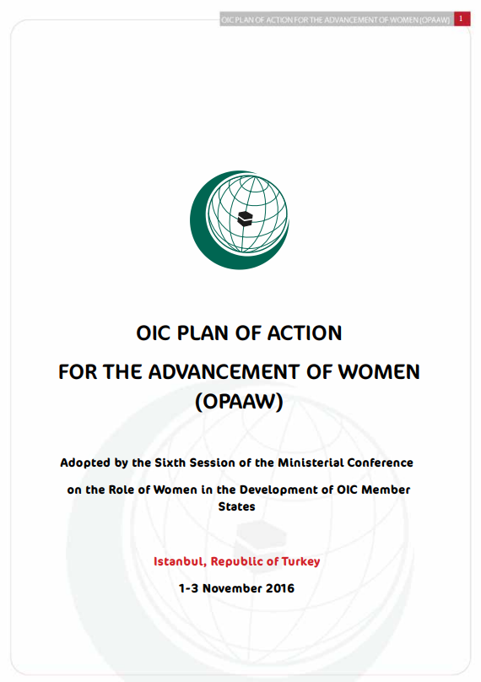
RESEARCH IN ACTION
03
02
01
IMPLEMENTATION SURVEYS
STRATEGIES & COOPERATION FRAMEWORKS
SECTORAL REPORTS

Slide 18
UTILIZING RESEARCH TO PROMOTE SOUTH-SOUTH COOPERATION
Proposing broad policy
Evaluating the performance
recommendations and cooperation project ideas
of OIC Countries (as a group) using key indicators
KNOWLEDGE EXCHANGE
Using policy research to
facilitate the development and implementation of critical strategic frameworks
Identifying problems,
POLICY COHERENCE
challenges and prospects
Active involvement in
Highlighting
the monitoring and evaluation of strategic frameworks in OIC member countries
success stories

Slide 19
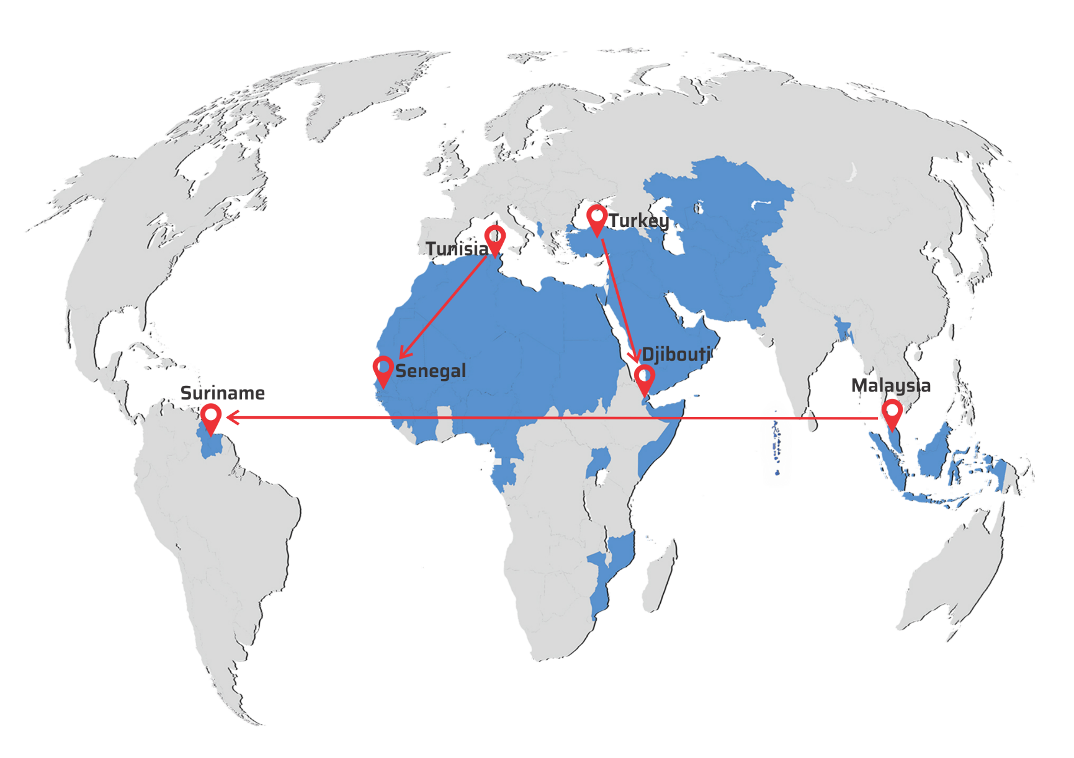
SESRIC CAPACITY BUILDING PROGRAMMES: MATCHING NEEDS AND CAPACITIES
Central Banks
Diplomacy
Agriculture
Tourism
Health
Environment
Stock Exchanges
Poverty Alleviation
Public Audit
Treasury
Railway
Cotton

Slide 20
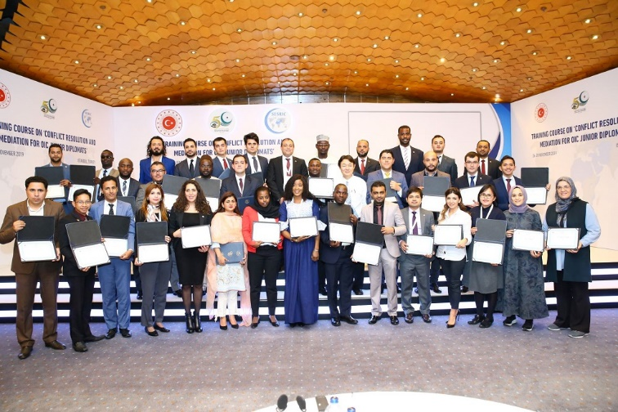
SESRIC CAPACITY BUILDING PROGRAMMES:
IMPLEMENTATION MODALITIES
TRAINING COURSES
STUDY VISITS
TRAINING WORKSHOPS
Training Course on “Conflict Resolution and Mediation” for Junior Diplomats from OIC Member Countries, November 2019

Slide 21
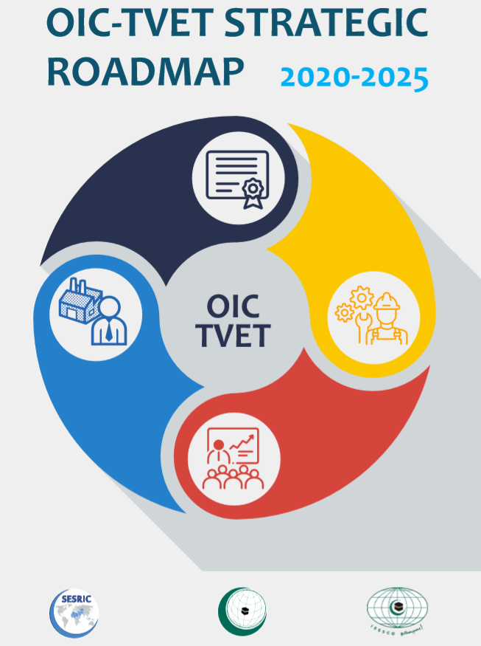
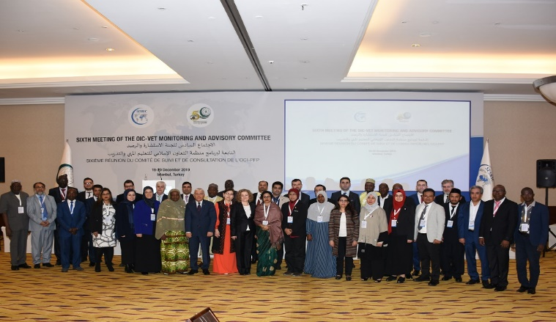
OIC-VOCATIONAL EDUCATION AND TRAINING (OIC-VET) PROGRAMME
Training Courses
Training Workshops
Study Visits
Projects
Training of Trainers
Sixth Meeting of the Monitoring and Advisory Committee (MAC), December 2019
OIC-VET Implementation Modalities

Slide 22
SESRIC TECHNICAL COOPERATION MODALITIES
MOUs
NETWORKS
REVERSE LINKAGES
PORTALS

Slide 23
SESRIC COOPERATION PARTNERS
National Institutions
OIC Institutions
International Institutions
NGOs

Slide 24
Thank You
www.sesric.org
@sesric

