Slide 1
Ministry of Healthcare and Social Development of the Republic of Kazakhstan
Systemic measures to ensure productive employment for Kazakhstan
Governmental program: “Road Map of Employment 2020”
Ankara, 2016

Slide 2
Content
Indicators of the Labour Market of Kazakhstan
The Governmental program: purpose and objectives
Targets of the Program
Three areas
Results of the implementation 2011-2016

Slide 3
Indicators of the Labour Market of Kazakhstan
thousand . people
Years | Economically active | Employed | Unemployed | Unemployment rate | Self-employment | Unproductive self-employment
2010 | 8 611 | 8 114 | 496 | 5,8 | 2 705 | -
2011 | 8 775 | 8 302 | 473 | 5,4 | 2 720 | -
2012 | 8 982 | 8 507 | 475 | 5,3 | 2 693 | -
2013 | 9 041 | 8 571 | 471 | 5,2 | 2 621 | 1 011
2014 | 8 962 | 8 510 | 451 | 5,0 | 2 400 | 709
2015 | 9 075 | 8 624 | 451 | 5,0 | 2 329 | 513
2016 -2nd quarter | 8 932 | 8 485 | 447 | 5,0 | 2 179 | 309
mln. people
Compared to 2010
The number of unemployed people decreased to 9,8%
The number of self-employed people decreased to 19,5%
At the same time , the growth :
EAP to 3,7%
Employed 4,5%
Wage workers to 16,6%

Slide 4
Road map of employment 2020
The purpose of the Program
Increasing the level of employment, the promotion of well-being improvement, reducing unemployment
The objectives of the Program
Engaging unproductively self-employed, unemployed and the target population into active measures of employment promotion;
Development of human resources;
Improving the provision of targeted social assistance.

Slide 5
Targets of the Program
by 2020:
1) the unemployment rate will not exceed 5,0 %;
2) female unemployment rate will not exceed 5,5%;
3) youth unemployment (15-28 years) will not exceed 4,6%;
Participants of the Program
Participants of the program are the citizens of the Republic of Kazakhstan including unemployed, part-time, low-income, self-employed citizens, as well as immigrants and repatriates and other categories of citizens

Slide 6
I. PROVIDING EMPLOYMENT THROUGH THE DEVELOPMENT OF INFRUCTRUCTURE, HOUSING & COMMUNAL SERVICES
This allows to efficiently create workplaces and control the unemployment rate
Within this framework, the provision is made for employment at workplaces related to:
overhaul, medium and current repairs of objects:
housing and utilities sector
social and cultural facilities
engineering and transport infrastructure
CONSTRUCTION OF HOSPITALS IN RURAL AREAS
IMPROVEMENT OF RURAL SETLEMENTS

Slide 7
II. PROMOTING BUSINESS INITIATIVES
This will significantly expand villagers' ability to organize business and will contribute to the growth of employment in rural areas and support the comprehensive development of villages
The measures of promoting business:
Free training for basic skills of business
Provision of microloan for 5 years (up to 20 000$)
Support of the project up to 1 year

Slide 8
III. TRAINING AND ASSISTANCE WITH EMPLOYMENT AND RESETTLEMENT, TAKING INTO ACCOUNT THE REAL DEMAND OF THE EMPLOYER
Training and assistance:
Organization of social career counseling, advice on training, employment
Training (with financial aid, covering living & transport expenses)
Employment:
Social workplaces (state subsidies - 65%, employee - 35%)
Youth practice (for 6 month)
Public works

Slide 9
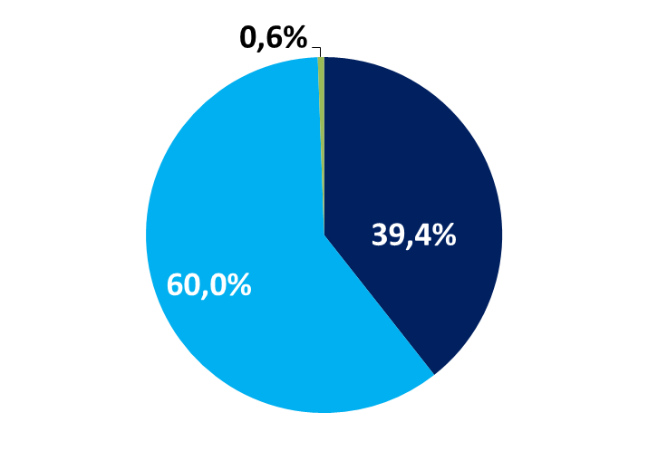
Results of the Program 2011-2016
Structure of the participants
51,5% participants are young people under the age of 30 years
48,6% participants are women
Part-time employers
unemployed
Self-employed

