Slide 1
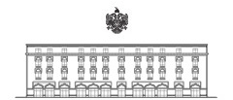
"Providing opportunities in employment and economic development for people with disabilities in Albania" ​
Istanbul, Turkey
26-28 October 2016
MINISTRY OF URBAN DEVELOPMENT
REPUBLIC OF ALBANIA

Slide 3
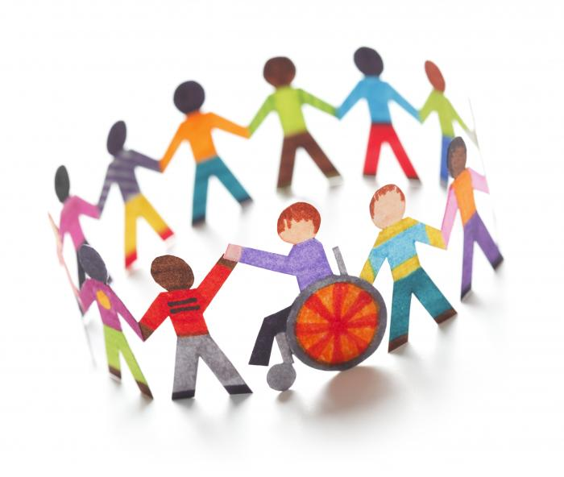
DISABILITY AWARENESS
“Disability is the process which happens when one group of people create barriers by designing a world only for themselves, not taking into account the impairments other people have.”

Slide 4
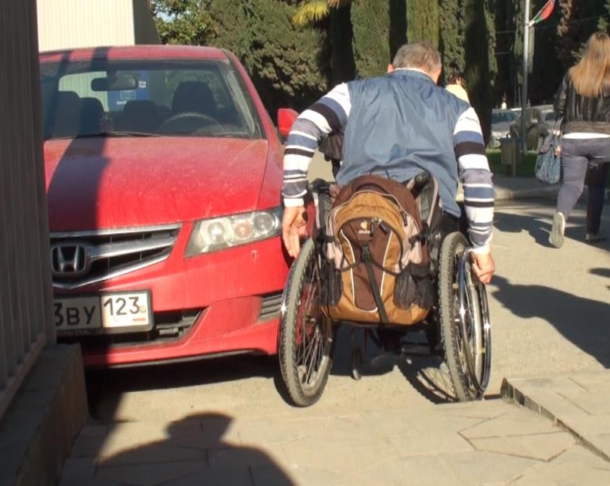
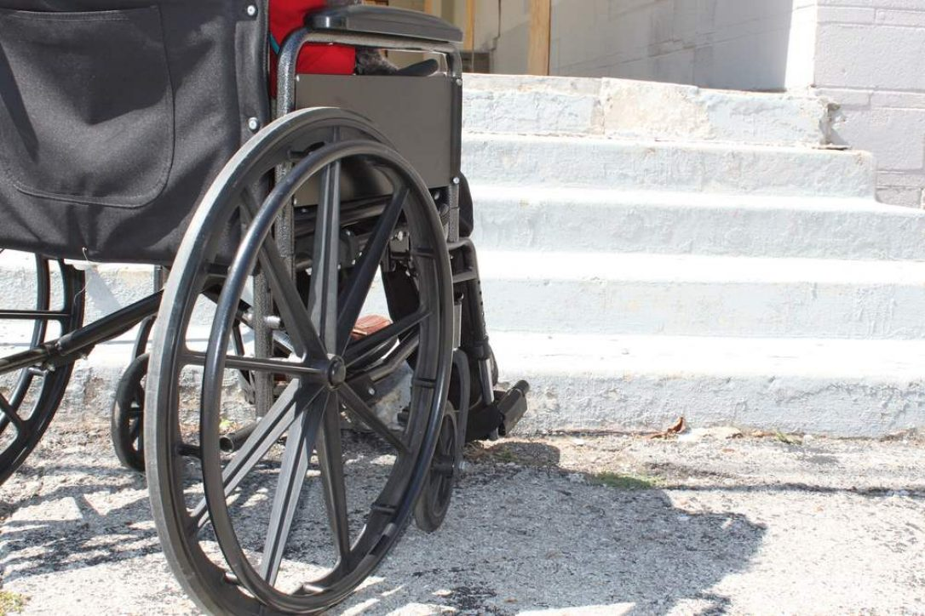
Disability relates to the interaction between the person with the impairment and the environment. It has a lot to do with discrimination, and has a lot in common with other attitudes and behaviors such as racism and sexism that are not acceptable in society.

Slide 5
PROFILE OF THE DISABLED POPULATION IN ALBANIA
Persons with disabilities in Albania are a sizeable vulnerable population group. The 2011 Census informs that 137,435 persons of the age 15 years old and over, of which 75,239 women, live with disabilities.
*United Nations Development Programme (UNDP) in Albania

Slide 6
DISABILITY PREVALENCE BY TYPE OF IMPAIRMENT, ALBANIA (%)

Slide 7
DISABLED INDIVIDUALS ARE LESS INTEGRATED IN THE LABOR MARKET
In Albania, disabled adults are much less likely to be participating in the labor market than their non-disabled peers. Disabled adults are 5 times less likely to be working than the non-disabled population.
8 in 10 disabled working-age adults are out of the labor force, i.e. neither working nor looking for work.
Workers with disability are much more likely to be working as family workers or self-employed without employees than their valid counterparts.

Slide 8
DISABILITY AND EMPLOYMENT

Slide 9
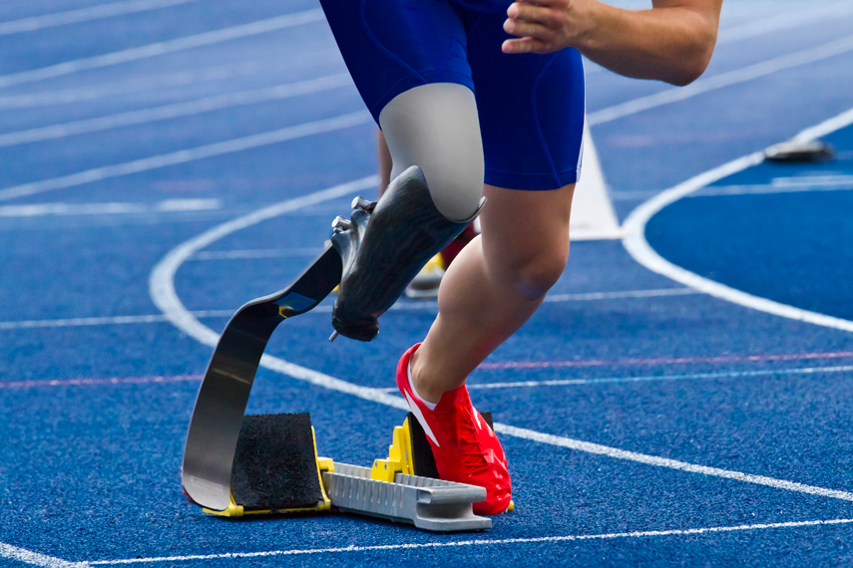
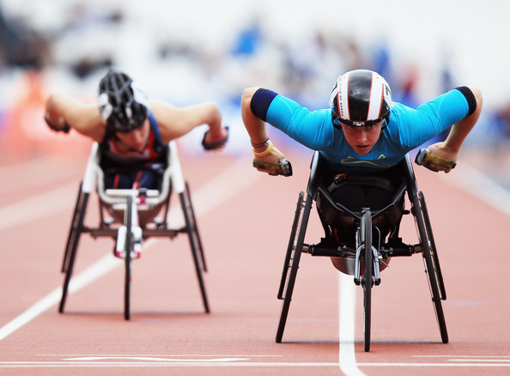
LEGISLATION IN ALBANIA
UN Convention on the Rights of Persons with Disabilities and according to NGOs there have been positive changes in legal provisions.
The Law on Work Promotion of Persons with Disabilities
Law on Economic Aid
Law on Accessibility and Inclusion.
Law "On inclusion and accessibility of Persons with Disabilities”

Slide 10
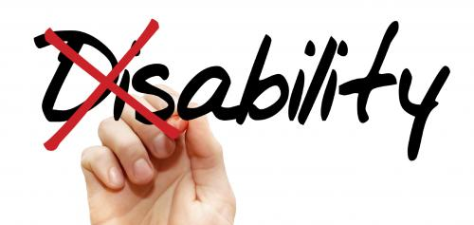
Legal frame
Disabled people officially are entitled to all human rights, (education, employment, health, etc.) and of the freedoms (opinion, expression, etc.).
The constitution (article 1/f) stipulates that the state and the government must act in favor of disabled persons in fields of health rehabilitation, the special education, the social integration and living conditions improvement.
According to these arrangements a certain number of laws and decrees have been approved, notably on legal statutes of various groups of disabled persons and on social and health care.

Slide 11
THE NATIONAL STRATEGY ON PEOPLE WITH DISABILITIES IN ALBANIA
The National Strategy on People with Disabilities in Albania represents the decisive will of all parties involved to harmonies the Albanian policy on people with disabilities with the international framework of the United Nations, the Council of Europe and the European Union.
The Strategy is designed to improve the living conditions of people with disabilities in the fields of education, employment, support services and free access.

Slide 12
FUNDAMENTAL PRINCIPLES OF THE STRATEGY
The Principle of Civil Rights, Equality and Non-Discrimination
The Principle of Self-Determination that enables them to an independent life.
The Principles of Inclusion, Participation and Equal Opportunities
The principles of Free Access and Barrier Free Environments
The Principles of Prevention, Early Detection and Early Intervention
The Principle of Rehabilitation to eliminate a disability or prevent its aggravation
The Principle of Finality according to which the necessary assistance must be offered to every disabled person and persons who are in danger of becoming disabled

Slide 13
The overall objective of the National Strategy on People with Disabilities is to ensure significant improvement in the status and life quality of people with disabilities in the Republic of Albania in accordance with UN Standards and Equal Opportunity Acts.
Objective: Provide opportunities in employment and economic development for people with disabilities
Provide education and training opportunities
Support options to achieve employment.
Educate employers about the abilities and capacities of people with disabilities.
Provide information about career options and assistance available.
Adjustment of working places
Provide communication services, resources and flexible workplace options.
developing more flexible income support benefits
Etc

Slide 15
EMPLOYMENT POLICIES
Regarding employment policy, MoSWY has continued to implement the measures of the action plan strategy of the National Strategy for Employment and Skills 2014-2020 in collaboration with implementing institutions, National Employment Service (NES) and other institutions of dependence.
DCM No.248, date 30.04.2014 “On employment promotion program for persons with disabilities” amended with DCMNo. 460, date 9.07.2014.
Law Nr.93 / 2014 dated 25.07.2014 "On Inclusion and Accessibility of Persons with Disabilities";

Slide 16
SOCIAL HOUSING STRATEGY
Ministry of Urban Development adopted by the Decision of Council of Ministers no. 405, dated 01.06.2016 the Strategy and its Action Plan.
The main goal of the strategy is to: "Provide solutions available, accessible, affordable and quality housing for vulnerable groups in particular, e.g. Roma and Egyptian communities, orphans, persons with disabilities, women who are victims of domestic violence etc.
.

Slide 17
EXISTING SITUATION IN ALBANIA
Persons with disabilities are not yet fully integrated in the Albanian society. During the recent years, a range of legislation and policies relevant to the promotion and protection of the rights of persons with disabilities has been approved in Albania.
The National Strategy on Persons with Disabilities (2005) and the associated action plan
Social Protection Strategy (2007)

Slide 19
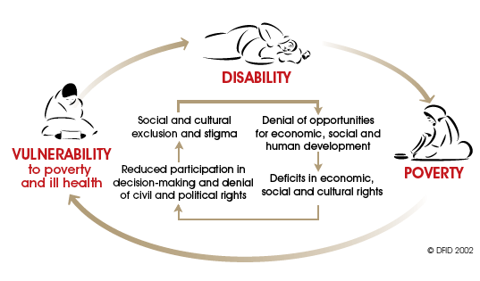
DISABILITY, POVERTY AND SOCIAL EXCLUSION ALBANIA
Disability may lead to lower living standards and poverty through adverse impact on education, employment, earnings, and increased expenditures related to disability. Stigma associated with a health condition may lead to activity limitations and participation restrictions given a particular social and cultural context and it might be worsened by the stigma associated with poverty.

Slide 20
Future steps shall also be undertaken:
Building up structures to enable people with disabilities to take part in all sectors of social and cultural life.
By abolishing information-, communication- and transportation-barriers
By implementing disability issues

Slide 21
NEEDS OF DISABLED PERSONS IN ALBANIA TO ADDRESS
Bad quality services, not accessible, geographically limited with untrained staff;
Weak access to information (on rights, services, procedures, etc.);
Isolation and solitude, self-denigration, weak family cohesion, stigmatization;
Unemployment and poverty,
Unsuitable education system, using obsolete methods;
Limited physical accessibility (displacements, transportation, etc.).

Slide 22
FIELDS OF INTERVENTION / ACTION PLAN
1. Accessibility
2. Services
3. Employment, Education and Vocational Training
4. Capacity Building
5. Legal Framework and Research

Slide 23
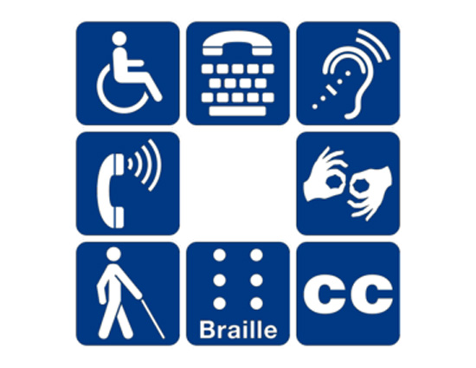
Measures to be taken
universal design features such as elevators, ramps, and clear signage.
• international symbols in materials, on websites

Slide 24
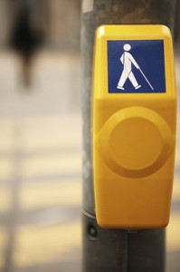
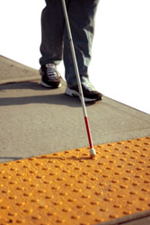
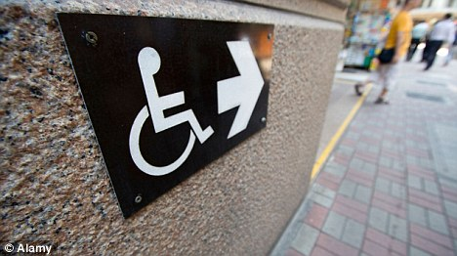
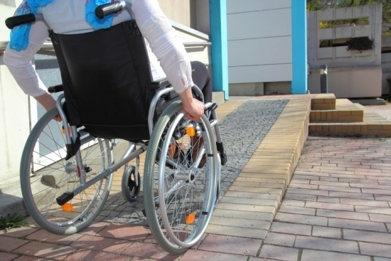
ACCESSIBILITY means:
• accessible path to enter the building
• accessible parking
• accessible common areas
• accessible to move around
• accessible meeting, learning and conference spaces
• automatic doors
• accessible emergency plan
etc

Slide 25
MANUAL FOR DESIGNERS
Based on Regulation "For the use of the facility by persons with disabilities "
Road crossings
Parking
Ramps
Stairs
Building entrances
Elevator
Houses
Hygiene services
Studying and Working Environments
Recreational and entertainment facilities

Slide 26
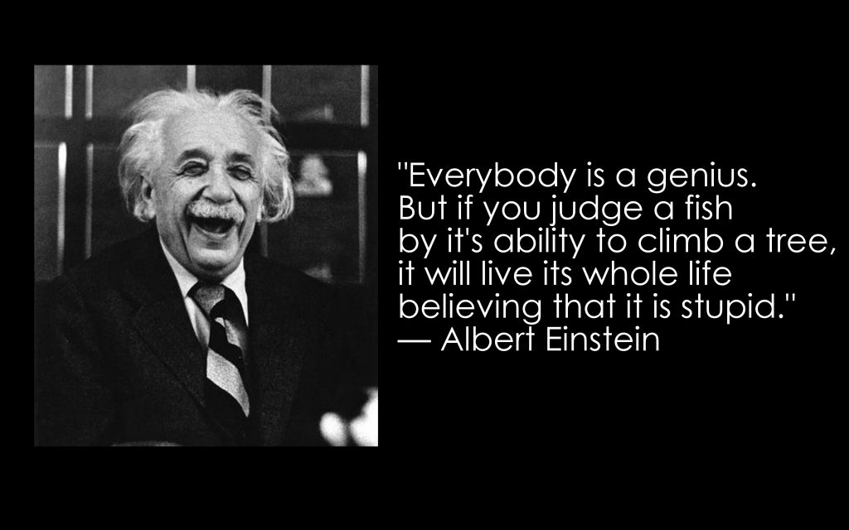

Slide 27
THANK YOU !

