Slide 1
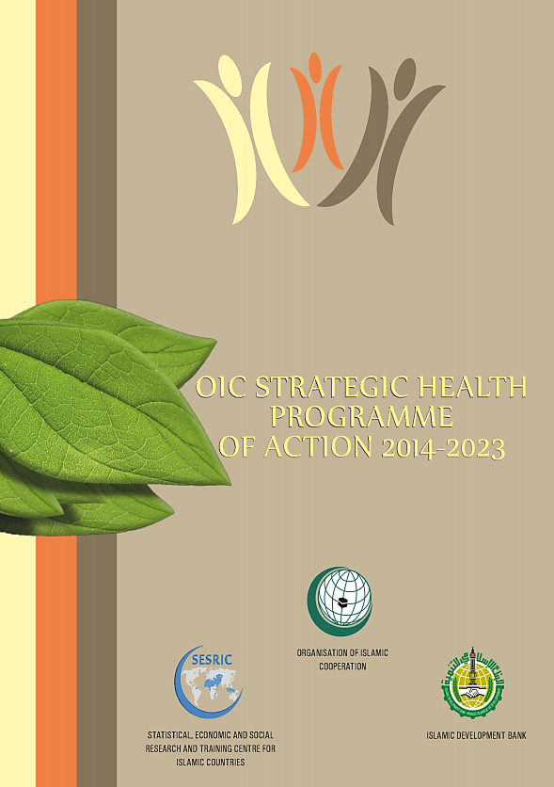
OIC Strategic Health Program of Action
2014-2023 (OIC-SHPA)
18 April 2018, Istanbul, Turkey
SESRIC

Slide 2
Outline
OIC HEALTH STRUCTURE
OIC STRATEGIC HEALTH PROGRAMME OF ACTION (SHPA)

Slide 3
OIC-HEALTH STRUCTURE
Islamic Conference
of Health
Ministers
ICHM
Turkey
LCC 1
Medicines, Vaccines and Medical Technologies
Thematic Area 4
Emergency Health Response and Interventions
Thematic Area 5
Indonesia
Malaysia
LCC 4
Saudi Arabia
LCC 3
Sudan
LCC 5
Information, Research, Education and Advocacy
Thematic Area 6
Lead Country Coordinators Group
LCCG
Health System Strengthening
Thematic Area 1
Disease Prevention and Control
Thematic Area 2
Morocco
LCC 6
Maternal, New-born and Child Health, and Nutrition
Thematic Area 3
Bahrain
LCC 2
Steering
Committee
on Health
SCH

Slide 4
OIC Strategic Health Programme of Action
(OIC-SHPA) 2014-2023

Slide 5
What’s OIC-SHPA 2014-2023?
A framework of cooperation among OIC member countries, relevant OIC institutions and international organizations in the domain of health;
Aims to strengthen health care delivery system and improve health situation in OIC member countries especially by facilitating and promoting intra-OIC transfer of knowledge and expertise;
Adopted by the 4th Session of the Islamic Conference of Ministers of Health held in Jakarta on 22-24 October 2013

Slide 6
OIC-SHPA 2014-2023
1- Health System Strengthening
Thematic Areas of Cooperation
2- Disease Prevention and Control
3- Maternal, New-born and Child Health and Nutrition
4- Medicine, Vaccine and Medical Technologies
5- Emergency Health Response and Interventions
6- Information, Education, Research and Advocacy

Slide 7
What’s Implementation Plan of OIC-SHPA?
Defines TIMELINE for implementation (short, medium and long term)
Identifies Key Performance Indicators (KPIs) to monitor the implementation
Proposes Implementing Partners (both national and international institutions)
Describes proposed actions/activities under each of the 6 TA

Slide 8
Thematic area 1: Health System Strengthening

Slide 9
Life expectancy at birth has increased by 5 years between 1990 and 2013
1990
2013
5.8 years
75.3
80.8
66.3
70.1
64.9
70.8
60.5
63.9
OIC Non-OIC Developing Developed World
Between 1990-2013 average LEB has increased from 60.5 years to 66.3
years in OIC countries.
However, OIC countries are still lagging behind the world by 4.5 years
and non-OIC developing countries by 3.8 years.
Source: World Bank, World Development Indicators 2015

Slide 10
Comparatively low financing for health (2000-2013)
2000
12.6
2013
10.1
10.0
9.1
6.4
5.5
3.9
4.4
OIC Non-OIC Developing Developed World
OIC countries spent only 4.4% of GDP on health sector compared to 10.0%
in the world and 6.4% in non-OIC developing countries.
Source: WHO Data Repository 2015

Slide 11
Heath workforce just above the crisis level
(2007-2013*)
Physicians Nurses and midwives Threshold
86
27
31
17
32
8
14
15
OIC Non-OIC Developing Developed World
There were only 25 health personnel (physicians, nurses and midwives) per 10,000 people in OIC countries compared to 41 in Non-OIC Developing countries and 46 health personnel in the world.
Only 27 members meet the critical threshold of 23 health personnel per
10,000 people.
Source: WHO Data Repository 2015

Slide 12
Low availability of health infrastructure (2013)
28
24
20
16
12
8
4
0
OIC
24.4
Non-OIC developing
World
14.8
6.7
2.1
1.6
2.9
1.5
1.3
0.9
Health posts Health centres Hospitals
Health care facilities are critical components of an efficient and effective health care system.
With 6.7 health posts and less than one district, provincial and specialized hospital per 100,000 people, OIC countries are lagging behind the world and non-OIC developing countries
Source: WHO Data Repository 2015

Slide 13
Thematic Area 1: Health System Strengthening
Selected actions and activities from Implementation Plan
 Facilitate knowledge exchange and co-production of new knowledge among member countries through joint capacity building programmes.
 Review and upgrade the current status of the national health information system and its key elements.
 Conduct assessment based on balance between production of health manpower and their deployment and utilization by the health system.
 Start prepayment and risk pooling based health financing schemes to overcome financial barriers to health care access especially in rural areas.

Slide 14
Thematic area 2: Disease Prevention and Control

Slide 15
Bulk of U5 deaths caused by preventable diseases and complications (2013)
Pneumonia and prematurity are the top-2 causes of under five deaths
43% of under-five deaths in OIC countries caused by three infectious diseases: pneumonia/sepsis (23%), malaria (11%), and diarrhea (9%)
Source: WHO Data Repository 2015

Slide 16
Thematic Area 2: Disease Prevention and Control
Selected actions and activities from Implementation Plan
 Promote and organize (or support existing) cost –effective community awareness programs about preventive measures and the treatment methods.
 Implement programs that tackle the social determinants of diseases i.e. health in early childhood, health of urban poor, fair financing and equitable access to primary health care services; access to clean water, improved sanitation and hygiene services.
 Take steps on ratification of WHO FCTC, if not done so, and improve the
implementation of all MPOWER measures.
 Establish capacity building networks among the Disease Control and Prevention Centres/Institutions, including for mental health and substance use, in the member countries.
Notes:
FCTC: Framework Convention on Tobacco Control

Slide 17
Thematic area 3: Maternal, New-born and Child Health and Nutrition

Slide 18
Impressive decline in maternal mortality between 1990 and 2013
44%
Between 1990 an 2013, MMR per 10,000 live births declined by 44% in OIC countries.
Source: WHO Data Repository 2015

Slide 19
Infant mortality declined remarkably between 1990 and 2013
44%
84
62
63
47
1990
2013
31
34
OIC Non-OIC Developing World
Between 1990 an 2013, IMR per 1000 live births declined by 44% in OIC countries.
Still one in every 21 children dies before their first birthday in OIC countries compared to one in 30 children in the world.
Source: WHO Data Repository 2015

Slide 20
Significant births still taking place without skilled assistance (2008-2012*)
Births Attended by Skilled Health Personnel (%)
38% of total births are still taking place without receiving any assistance and care from skilled health personnel in OIC countries
Situation is critical in South Asia and Sub-Saharan Africa where un-attended births stands at 60% and 55% respectively
Source: WHO Data Repository 2015

Slide 21
Thematic Area 3:Maternal, New-born and Child Health & Nutrition
Selected actions and activities from Implementation Plan
 Develop home-based maternal, newborn and child care programmes based on successful models of community health workers depending on the needs and realities of each country.
 Improve awareness of women, families and communities about maternal and child life saving practices and existing services.
 Promote capacity building and disseminate best practices and lessons learned in the member countries in access to skilled health personnel during childbirth.
 Support public-private partnerships to improve the availability of staple foods enriched with key micronutrients.

Slide 22
Thematic area 4: Medicines, Vaccines, and Medical Technologies

Slide 23
Thematic Area 4: Medicine, Vaccine and Medical Technologies
With respect to production and supply of medicines, vaccines and medical technologies, OIC countries are characterised by low production capacities and rely heavily on imports to meet their domestic demand.
In 2013/14, 23 out of 48 OIC countries (48 per cent) have a health technology national policy. However, 25 countries (52 per cent) do not have any.

Slide 24
Thematic Area 4: Medicine, Vaccine and Medical Technologies
Selected actions and activities from Implementation Plan
 Facilitate training among member countries through sharing of knowledge and expertise for the development and strengthening of pharmacovigilance system.
 Improve investment climate by simplifying the requirements for doing
business in pharmaceutical and other medical products industry.
 Establish an intersectoral intra-OIC committee of experts on local production.
 Facilitate development of OIC regional pooled procurement mechanism which will enable local production to meet regional needs and allow for the mutual cooperation in increasing the availability of essential medicines and vaccines.

Slide 25
Thematic area 5: Emergency Health Response and Interventions

Slide 26
Thematic Area 5: Emergency Health Response & Interventions
In 2015, 30 of 50 conflicts recorded worldwide occurred in OIC countries.
As a direct outcome, today OIC countries account for 61.5% of all displaced population in the world with more than 25 million displaced people.
Natural disasters during the last four decades have witnessed a steeper upwards trend inside OIC countries, significantly increasing from around 681 recorded incidents in the 1990s to 1,747 in the 2000-2016.

Slide 27
Thematic Area 5: Emergency Health Response & Interventions
 Develop all hazards national policies and programmes on risk reduction and emergency preparedness in the health sector.
 Support the synergy of Public-Private Partnership for community empowerment in the field of disaster management.
 Establish a centralized health information system for timely reporting of
deaths, diseases, and emergency health logistics.
 Facilitate interregional partnerships and fund-raising for country-based capacity-building in the field of emergency health preparedness and response by supporting regional solidarity funds for emergency response.
 Establish OIC regional early warning and response mechanisms to prevent cross-border disease outbreaks.

Slide 28
Thematic area 6: Information, Education, Research and Advocacy

Slide 29
Thematic Area 6: Information, Education, Research & Advocacy
As of 2006 data, four OIC countries: Iran, Turkey, Pakistan and Indonesia were ranked among the top-20 countries with the most active medical schools. On the other hand, there was only one active medical school in Guinea Bissau, Gabon and Surinam.
Many OIC countries, especially those situated in the Sub-Saharan Africa, suffer from insufficient number of health professionals.
Many OIC countries are suffering from the poor level of health information and awareness. The situation is particularly critical in low income countries where many myths and taboos prevail, which lead to the low usage of health care services that are critical for the healthy survival of people.

Slide 30
Thematic Area 6: Information, Education, Research & Advocacy
Selected actions and activities from Implementation Plan
 Develop national strategy to promote disease prevention and healthy life styles involving all concerned partners.
 Secure IFA fatwa for all types of immunizations in OIC member countries and translate and disseminate this fatwa in local languages to address religious concerns regarding vaccination.
 Launch a tailor made OIC community health awareness programs for the clerks (imams).
 Establish a network of OIC health centers of excellence to promote harmonization of health care education and practices across OIC member countries.

Slide 31
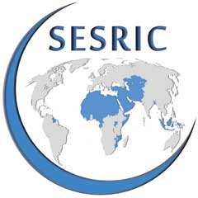
Thank you

