Slide 1
Work and Forms of Work Framework
Wachyu Winarsih, M.Si
Head of Sub Directorate of Labor Force Statistics
Directorate of Population and Labor Force Statistics
BPS - Statistics Indonesia

Slide 2
BPS - Statistics Indonesia
Contents
New Statistical Definition of Work
Work and the SNA 2008
Form of Work

Slide 3
BPS - Statistics Indonesia
Work: New statistical definition
“Any activity performed
by persons of any sex and age
to produce goods or provide services
for use by others or for own use”
Para 6,Resol I. (19th ICLS, 2013)
Concept for reference purposes
Not for direct measurement !
Recognizes all productive activities as work
But WORK ≠ Employment

Slide 4
BPS - Statistics Indonesia
Work and the 2008 SNA
Aligned with General production boundary (2008 SNA)
Can be performed in any kind of economic unit
Market units (i.e. for profit units, such as corporations, quasi-corporations and household unincorporated market enterprises)
Non-market units (i.e. government & non-profit institutions)
Households producing goods or services for own final use
Irrespective of formal, informal nature or legality of activity
Enables coherence between work statistics and economic statistics

Slide 5
BPS - Statistics Indonesia
Work and the 2008 SNA
“Economic production may be defined as
an activity carried out under the
control & responsibility of an institutional unit that
uses inputs of labour, capital, goods & services
to produce outputs of goods or services”
Para. 6.24, 2008 SNA
Defines the General production boundary

Slide 6
BPS - Statistics Indonesia
Work and the 2008 SNA
Activities
Productive activities
Market units
Incorporated, unincorporated
Goods
Non-market units
Government, Non-profit institutions
Services
Households
producing for own final use
Goods
Non-productive
activities
Services
Goods
Self-care
Sleeping
Learning
Own-recreation
Begging
Stealing
Services
Included
Previous activity scope for “employment”
New concept of “Work” == ALL productive activities
General production boundary
SNA production boundary

Slide 7
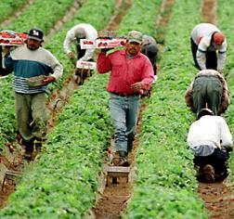
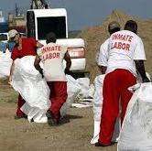
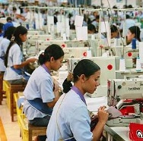
BPS - Statistics Indonesia
Forms of Work : Framework
Work
(i.e. ALL activities to produce goods and services)
For own final use
(by households)
For use by others (i.e. other units)
For remuneration (i.e. for pay or profit)
Without remuneration
Unpaid trainee work
Other work activities (e.g. unpaid compulsory work)
Volunteer work
Own-use production work
Employment
(work for pay or profit)
Reference concept for Labour Force statistics
Services
Goods
Services
Goods
S
G
S
G
G
S
SNA labour input

Slide 8
BPS - Statistics Indonesia
Forms of work : Basic concepts
Own-use production work
Activities to produce goods & services mainly for own final use by household
Employment work
Activities to produce goods & services [for others in exchange] for pay or profit
Unpaid trainee work
Activities to produce goods & services for others performed without pay in order to acquire workplace experience or skills
Volunteer work
Non-compulsory activities performed without pay to produce goods and services for others
Other work activities
E.g. Compulsory activities performed without pay to produce goods & services for others

Slide 9
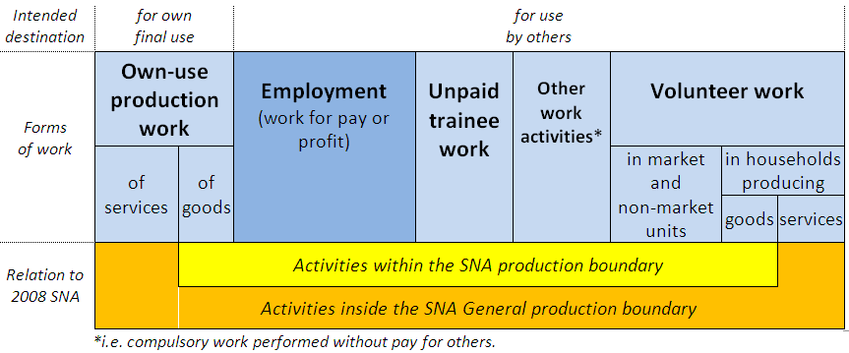
BPS - Statistics Indonesia
Correspondence with previous standards and with national practice
Previous scope of “economic activity” used to define the employed
In general countries use narrower scope to identify the employed

Slide 10
BPS - Statistics Indonesia
Relevance for Labour force statistics
Reference concept for
Labour force statistics
Employment definition refined as work for pay or profit
Narrower “employment” definition to serve as basis for labour force statistics
Other forms of work to be measured separately
ILO Department of Statistics
10

Slide 11
BPS - Statistics Indonesia
References:

Slide 12
Thank you

